Slide 1
Digital Portfolio
STUDENT NAME:DAKSHINA K
REGISTER NO AND NMID: 2428C0466 AND
6E189FC5B6FBDB08B3B4827C0D952150
DEPARTMENT: Bsc AI&ML
COLLEGE: KPR College of Arts & Science,Bharathiyar Un

Slide 2
PROJECT TITLE
E-LEARNING & ONLINE COURSES PORTFOLIO

Slide 3


AGENDA
Problem Statement
Project Overview
End Users
Tools and Technologies
Portfolio design and Layout
Features and Functionality
Results and Screenshots
Conclusion
Github Link
3/21/2024 Annual Review

Slide 4

PROBLEM STATEMENT
This portfolio showcases a range of e-learning and online courses designed to provide flexible, interactive, and effective learning experiences. Each course is created with engaging content, clear objectives, and practical assessments, enabling learners to upskill anytime, anywhere. Ideal for personal development, academic growth, or professional training in the digital era.

Slide 5

PROJECT OVERVIEW
Learn anytime, anywhere with flexible online courses.
Engaging content with videos, quizzes, and assignments.
Accessible and affordable for all learners.

Slide 6

END USERS
Students: Enhance academic learning and gain extra skills beyond the classroom.
Professionals: Upskill or reskill for career growth and certifications.
Organizations & Institutions: Train employees, provide continuous learning, and
improve workforce knowledge.

Slide 7

TOOLS AND TECHNOLOGIES
Learning Management Systems (LMS): Moodle, Canvas, Blackboard, Google Classroom
Content Creation Tools: Articulate 360, Adobe Captivate, Canva, Powtoon
Video Conferencing & Webinar Platforms: Zoom, Microsoft Teams, Google Meet
Assessment Tools: Kahoot, Quizizz, ProProfs Quiz Maker
Collaboration & Communication Tools: Slack, Trello, Padlet
Multimedia Tools: Camtasia, OBS Studio, Figma, Photoshop

Slide 8
PORTFOLIO DESIGN AND LAYOUT
Cover Page: Title, name, e-learning-themed visual.
Introduction & Overview: Brief description and key points.
Benefits & Types of Courses: Bullets, icons, or small infographic.
Course Design & Structure: Flowchart of modules, lessons, quizzes.
Assessment & Certification: Results table and certificate preview.
End Users & Tools: Icons or tables for learners, organizations, and technologies.
Conclusion: Short engaging paragraph with visual element.
8

Slide 9
FEATURES AND FUNCTIONALITY
Interactive & Flexible Learning: Videos, quizzes, and assignments accessible anytime, anywhere.
Progress Tracking & Assessment: Monitor performance and earn certificates.
Collaboration & Content Management: Discussion forums, easy course updates, and organized learning materials.

Slide 10
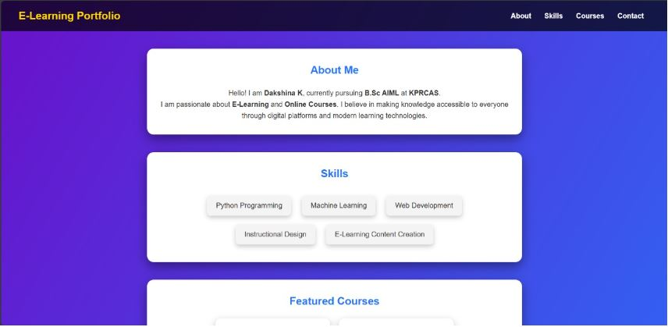

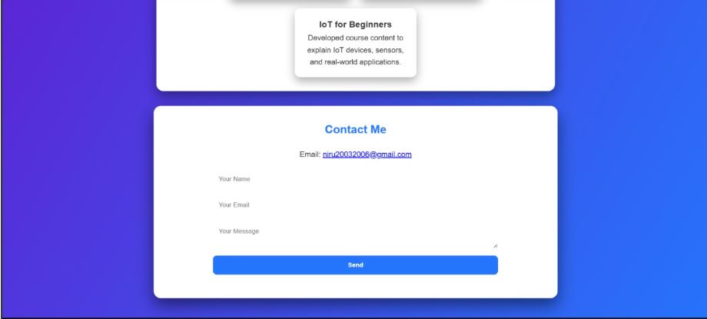
RESULTS AND SCREENSHOTS
Result:
- A professional portfolio website for E-Learning theme - Showcased courses: AI & ML Fundamentals, Web Development Bootcamp, IoT for Beginners - Improved online presence for professional and educational opportunities
3/21/2024 Annual Review
10

Slide 11
CONCLUSION
E-learning makes education flexible, accessible, and engaging. It helps learners gain new skills, track progress, and achieve certifications, empowering personal and professional growth anytime, anywhere.
11

Slide 12
Git hub Link:
Live Website:
https://your-username.github.io/e-learning-portfolio
GitHub Repository:
https://github.com/your-username/e-learning-portfolio

